Slide 1
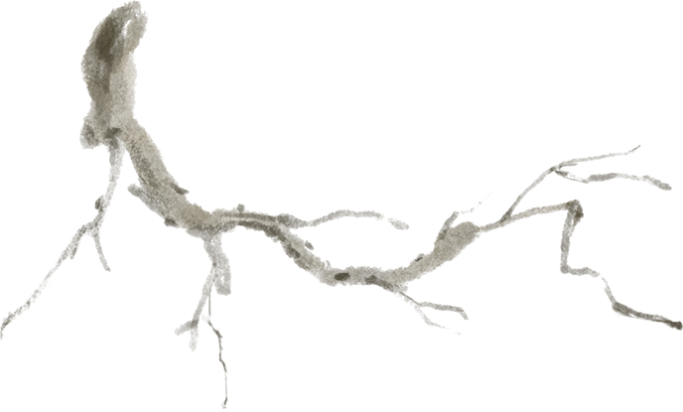






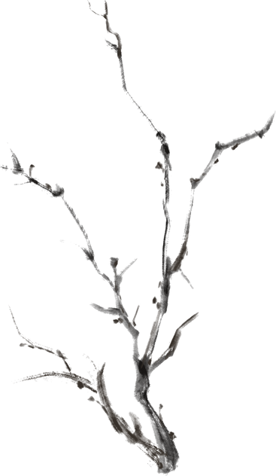

南宋
岳飞/《满江红》/《射雕英雄传》/辛弃疾
Yue Fei/Manjiang Hong/The Legend of the Condor Heroes/Xin Qiji
小组成员：郎竟茗，孙溯阳，王鸣一，章泽亮

Slide 2
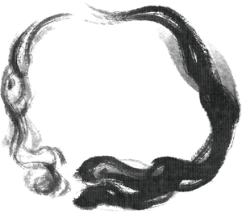
目录
壹
Yue Fei
贰
Manjiang Hong
叁
肆
Condor Heroes
Xin Qiji

Slide 3
one
Yue Fei

Slide 4
Profile of Yue Fei
Literature
Calligrapher；
Poet；
Military
Military strategist；
（ranked first in the Southern Song Dynasty "four generals"）
National hero；

Slide 5
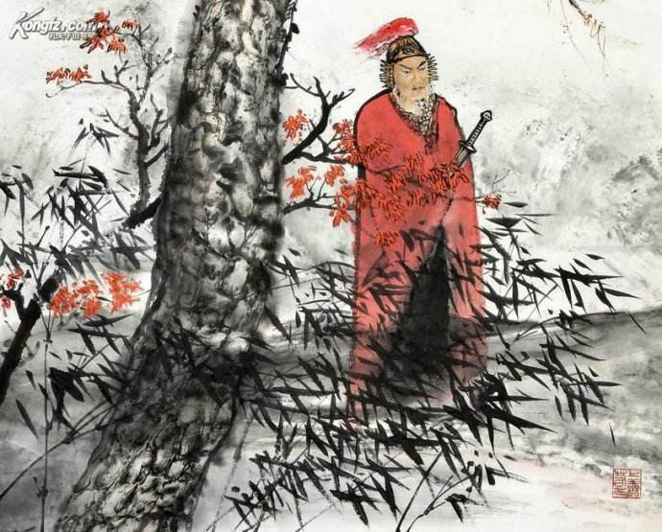
Tune: “Xiao Zhong Shan”
Last night the cold crickets ceaselessly sang.
They aroused my dreams from a thousand miles afar,
It was already the third watch.
I rose up and lonely walked around the doorsteps
All souls were quiet.
Through the screen the moon dimly shone.
All my life I devote to service of the state.
To my native land where the pine and bamboo are getting old,
My returning way has been barred.
I would like to put my thought to the jasper-mounted lute,
But, no-understanding friend,
Who would listen to my broken string?

Slide 6
Aspect of military
Aspect of personal life
1.Courage
（lead his men in a charge）
1.Dont covet enjoyment
Mercy
（take care of the soldiers）
2.Dont seek for fame and gain

Slide 7
two
Movie: Manjiang Hong

Slide 9
Main characters
01
02
03
04
As a descendant of the Jiajun army, he is extremely loyal. Despite knowing that he may not succeed, he persists in fighting for Yue Fei's wishes, demonstrating loyalty to the national cause and steadfastness to personal beliefs.
A complex character, torn between loyalty to Qin Hui and a lingering conscience, ultimately chooses to betray.
Appears polite and decorous on the surface, but is actually cunning and ruthless.
Sensitive and suspicious, as well as cold-blooded and cowardly. To preserve himself, he forsakes the national cause and reaches out to the Jin dynasty.
Zhang Da
Sun Jun
He Li
Qin Hui

Slide 10
The plot summary
The story of this film begins with the assassination of the Jin Dynasty's protocol officer due to fear that the contents of a secret letter would be revealed. Qin Hui, fearing exposure, dispatches Sun Jun, He Li, and Wu Yichun to investigate. Meanwhile, the conspirators behind the scenes, including Zhang Da, Ding Sanwang, and Yao Qin, are determined to get close to Qin Hui in order to assassinate him, disregarding their own lives and creating various deceptions to confuse him. In the end, several of them sacrifice themselves while Sun Jun escapes unharmed. In front of tens of thousands of troops, Qin Hui's body double recites the timeless poem "Man Jiang Hong," while Qin Hui himself is bound to a pillar and condemned by future generations.

Slide 11
three
The Legend of the Condor Heroes

Slide 12
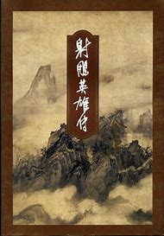
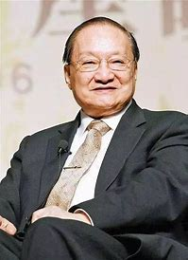
The Legend of the Condor Heroes
author：JinYong
A great writer
content
patriotism,
love,
life,
many encounter,
also tale about YueFei

Slide 13
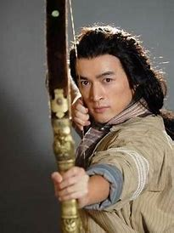

GuoJing
1、Barth
2、Main encounter and ability
3、Story with HuangRong
4、How to leave Mongolia
5、He's thinking about ability

Slide 14
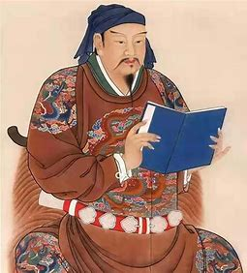
about YueFei
famous anti-Jin general in
the Southern Song Dynasty,
loyalty and bravery.
Book of Wumu

Slide 15
four
Xin Qiji

Slide 16
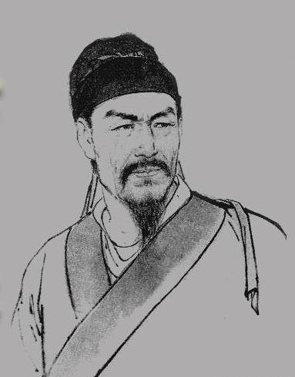
Profile of Xin
a master of the “Unconstrained School” of ci
Born in the North,but have the ambition to reconquest lost territory.
Joined a rebel army against the Jin dynasty,at age 21
Bumpy political career

Slide 17
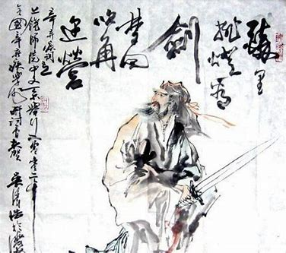
One of his poems
Dance of the Cavalry 《破阵子·为陈同甫赋壮词以寄之》
Though drunk, we lit the lamp to see the glaive;
Sober, we heard the horns from tent to tent.
Under the flags, beef grilled was eaten by our warriors brave
And martial airs were played by fifty instruments:
‘Twas an autumn maneuver in the field.

Slide 18
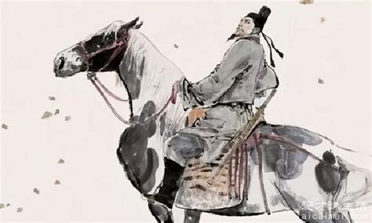
On gallant steed, running full speed,
We’d shoot with twanging bows
Recovering the lost land for the sovereign,
‘Tis everlasting fame that we would win.
But alas! White hair grows!

Slide 19
Xin's virtue
patirotic
integrity
演示文稿是一种实用的工具，可以是演示，演讲，报告等。大部分时间，它们都是在为观众服务。演示文稿是一种实用的工具，可以是演示，演讲，报告等。大部分时间，它们都是在为观众服务
演示文稿是一种实用的工具，可以是演示，演讲，报告等。大部分时间，它们都是在为观众服务。演示文稿是一种实用的工具，可以是演示，演讲，报告等。大部分时间，它们都是在为观众服务
演示文稿是一种实用的工具，可以是演示，演讲，报告等。大部分时间，它们都是在为观众服务。演示文稿是一种实用的工具，可以是演示，演讲，报告等。大部分时间，它们都是在为观众服务

Slide 20
Thank you
文学丨历史丨语文丨社科丨国学
小组成员：郎竟茗，孙溯阳，王鸣一，章泽亮

